Slide 1
Bon Voyage Exploria
Tour Package Website

Slide 2


Agenda
Flow chart
Registration Page
Login Page
Functionalities:
Admin:
Adding Tour Package
Adding Travel Agency
User:
Book Tour Package
Payment
A

Slide 3
Introduction
Bon Voyage Exploria aims to make booking of tour packages easier and faster by providing online interface where the users can select their desired tour packages and book the Packages .
Payment is also done easier by making it online .

Slide 4
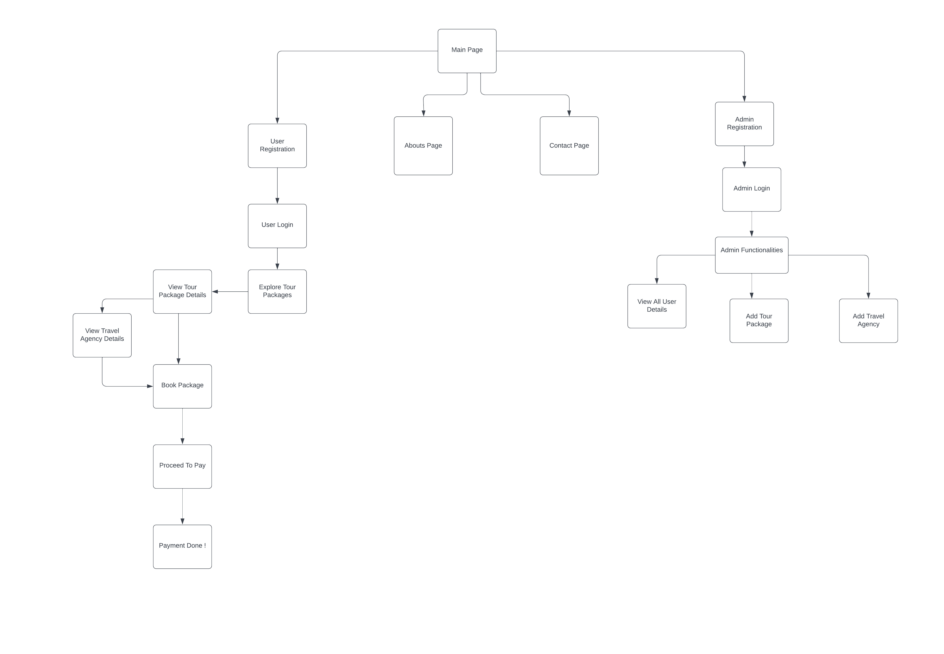
Flow Chart

Slide 5
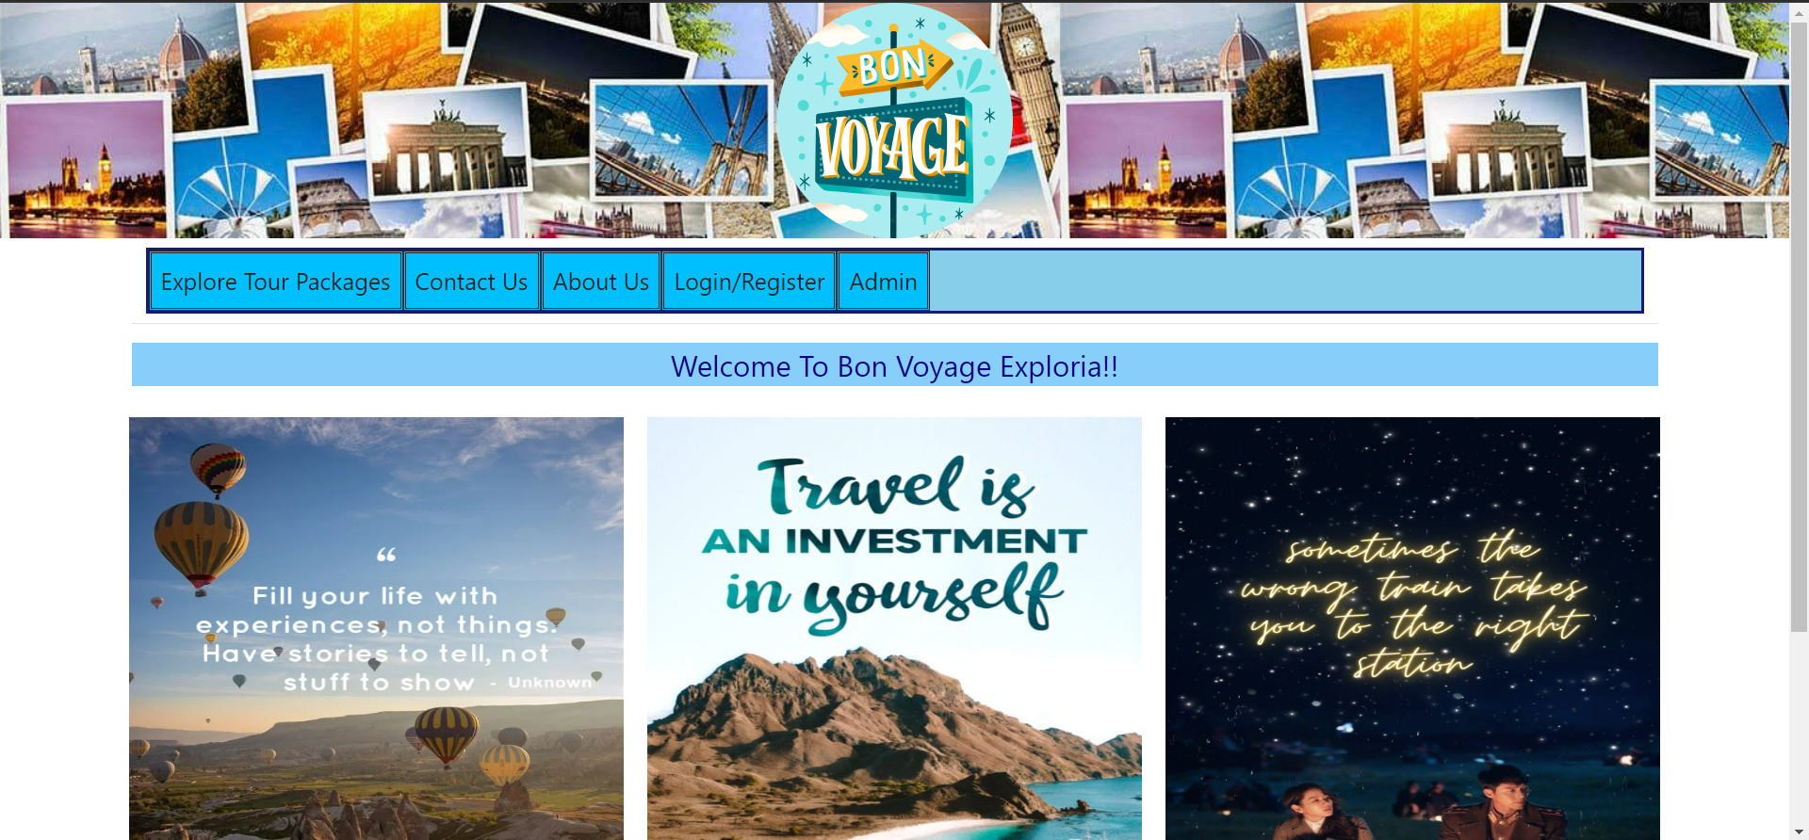
Main Page

Slide 6
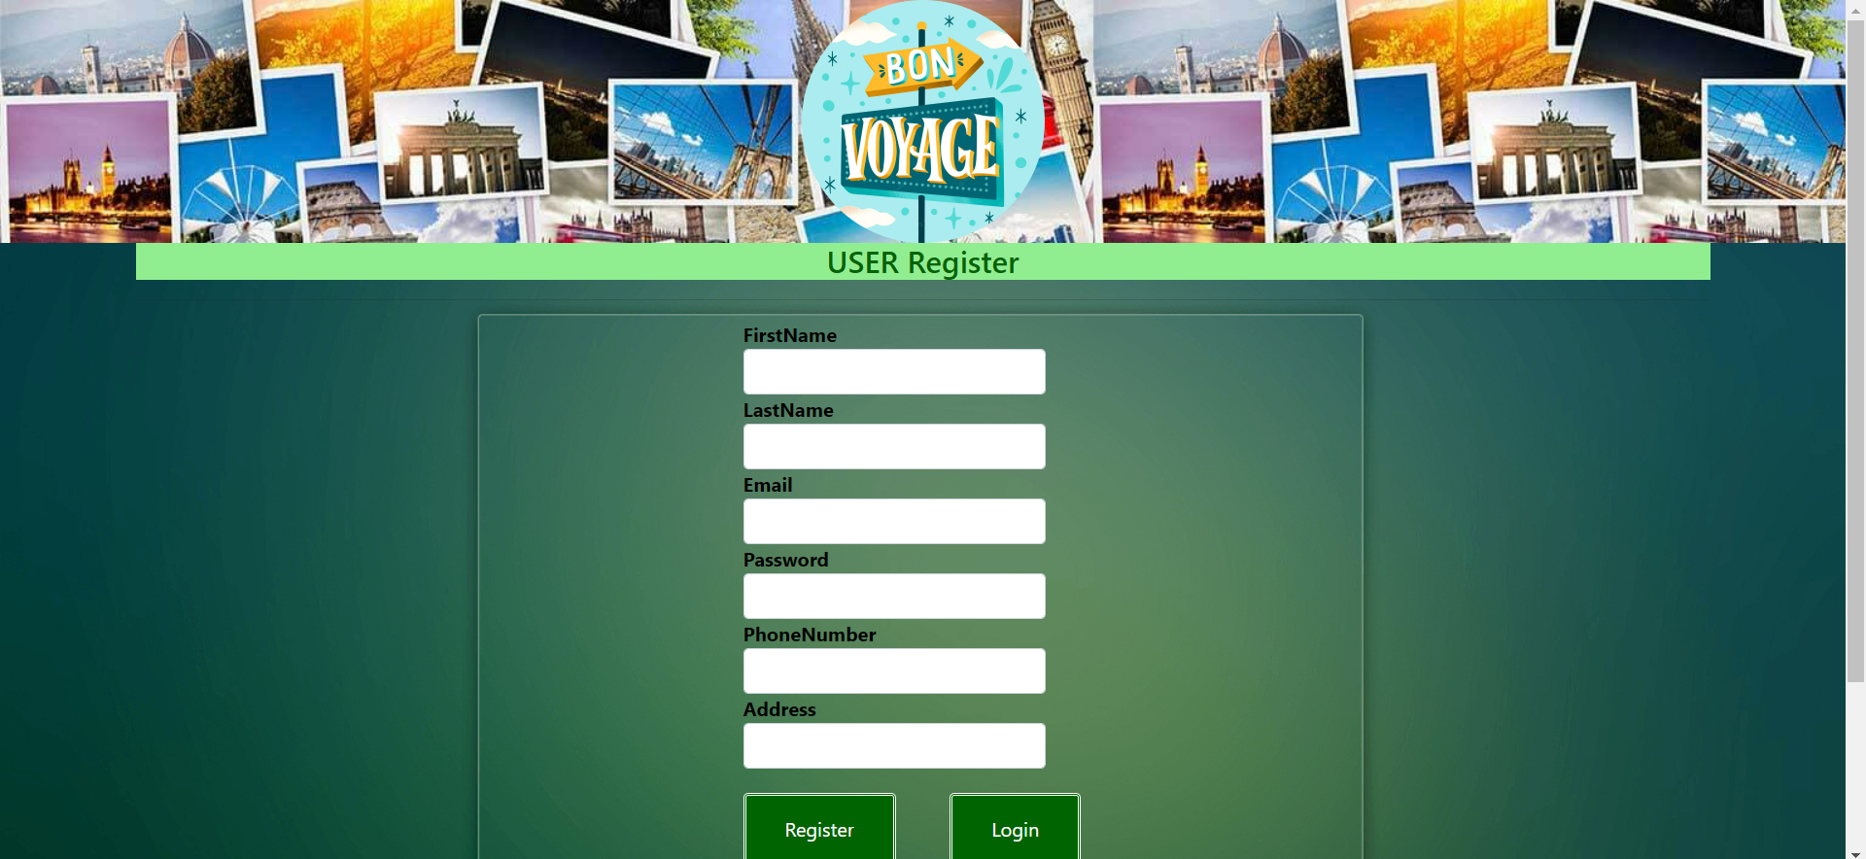
Registration Page

Slide 7

Login Page

Slide 8
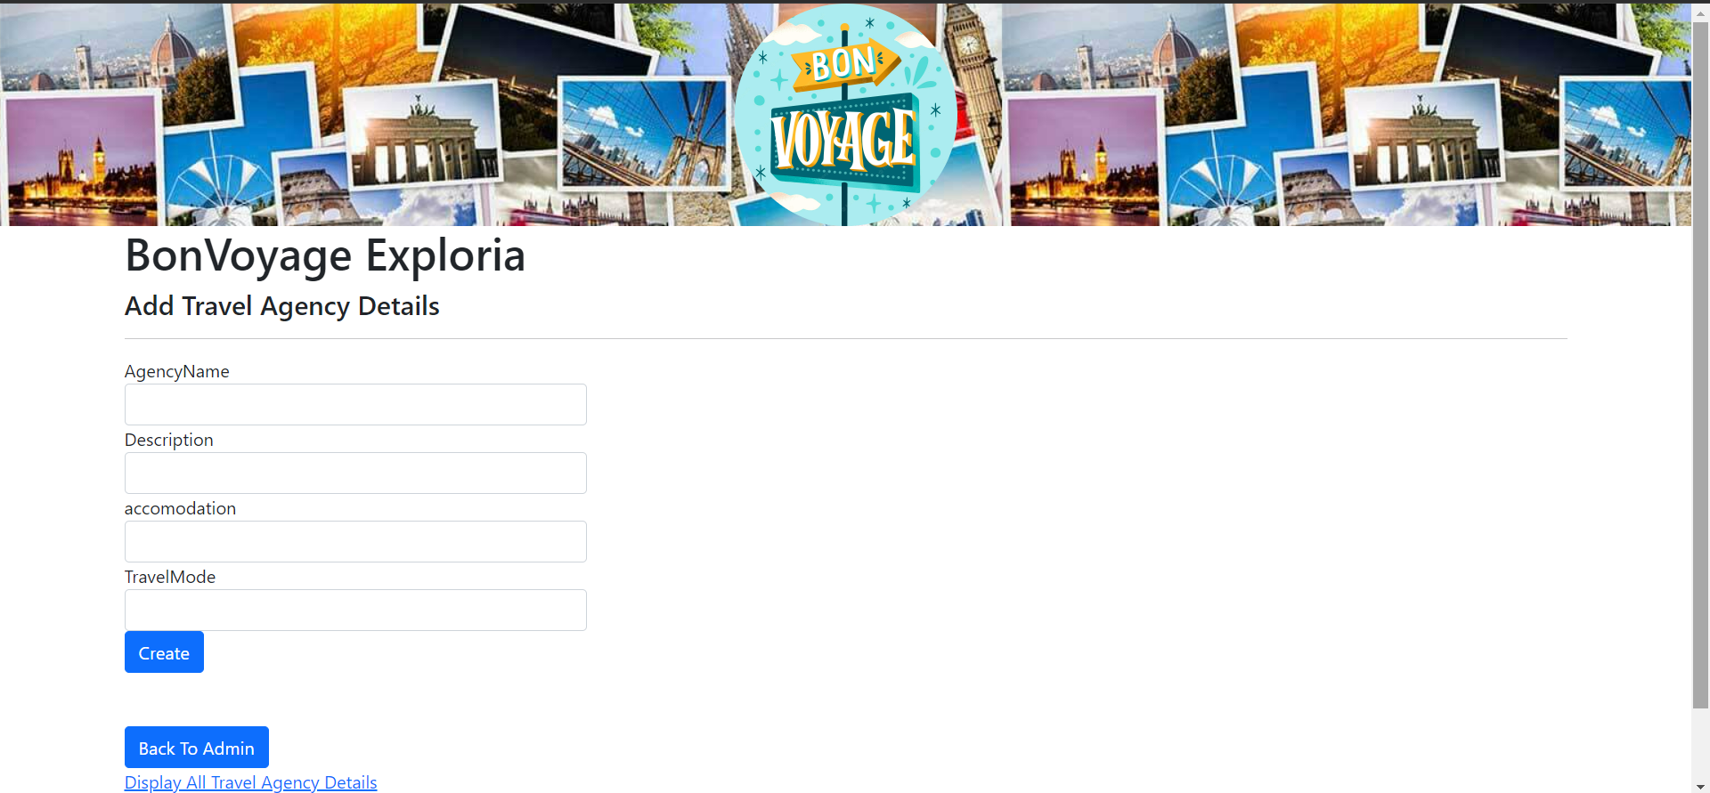
Admin Add Travel Agency

Slide 9
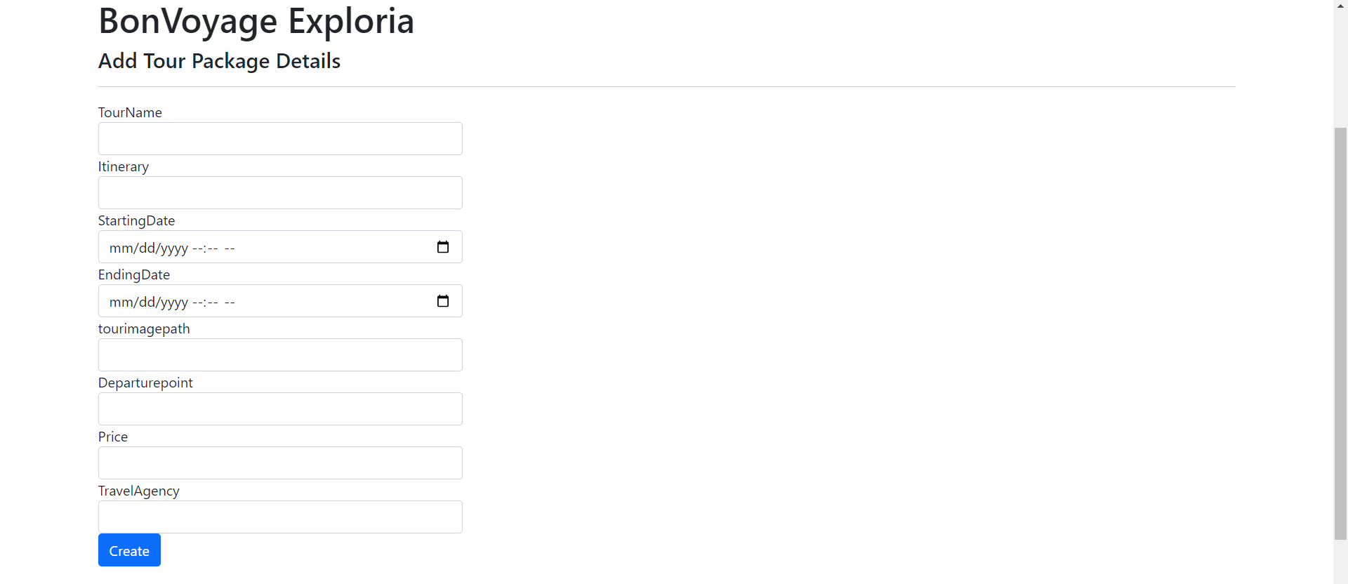
Admin Add Tour Package

Slide 10
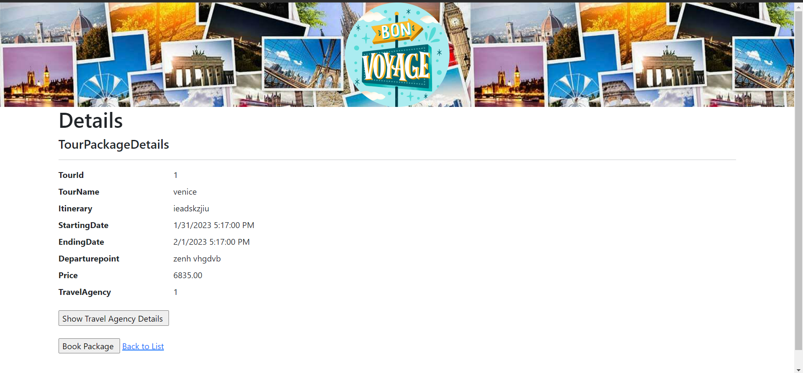
User Book Tour Package

Slide 11
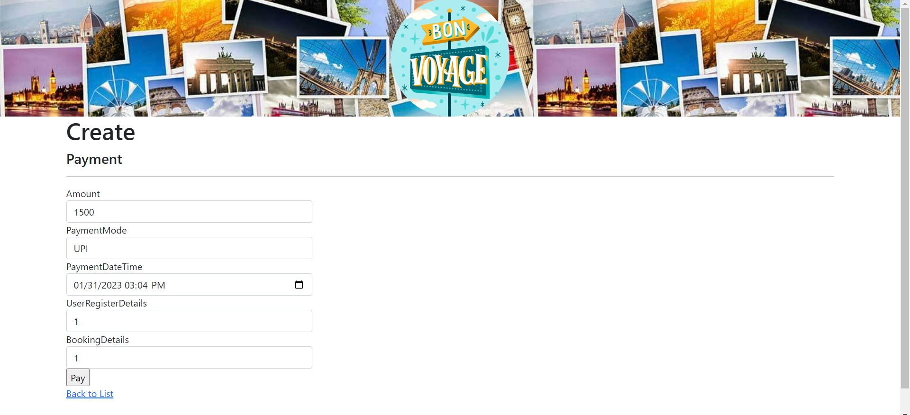
User Payment

Slide 12
Thank you

